Slide 1
LECTURE # 2
CHAPTER # 1

Slide 2
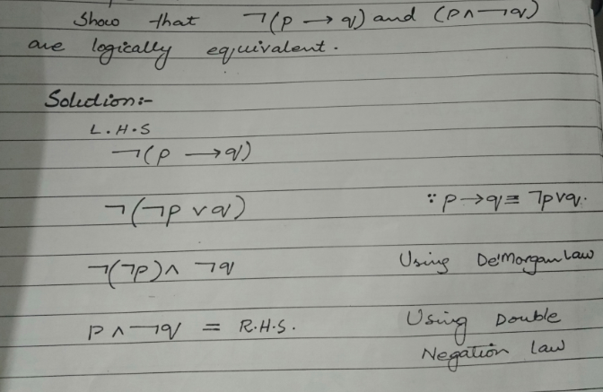

Slide 3
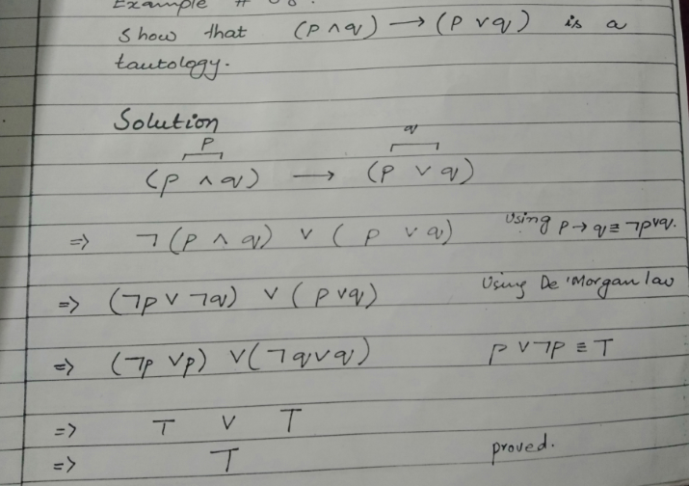

Slide 4
APPLYING LAWS OF LOGIC
Using law of logic, simplify the statement form
p ∨ [~(~p ∧ q)]
Solution:
p ∨ [~(~p ∧ q)] ≡ p ∨ [~(~p) ∨ (~q)] DeMorgan’s Law
≡ p ∨ [p∨(~q)] Double Negative Law: ~(~p) ≡ p
≡ [p ∨ p]∨(~q) Associative Law for ∨
≡ p ∨ (~q) Idempotent Law: p ∨ p ≡ p
That is the simplified statement form.

Slide 5

SIMPLIFYING A STATEMENT:
“You will get an A if you are hardworking and the sun shines, or you are hardworking and it rains.”
Rephrase the condition more simply.
Solution:
Let
p = “You are hardworking’
q = “The sun shines”
r = “It rains” .
The condition is (p ∧ q) ∨ (p ∧ r) Using distributive law,
(p ∧ q) ∨ (p ∧ r) ≡ p ∧ (q ∨ r)

Slide 6
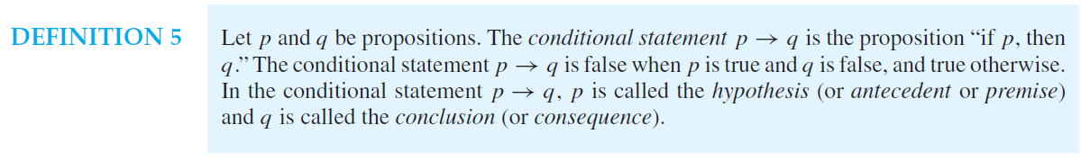
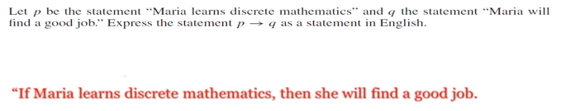
CONDITIONAL STATMENTS:
QUESTION:

Slide 7

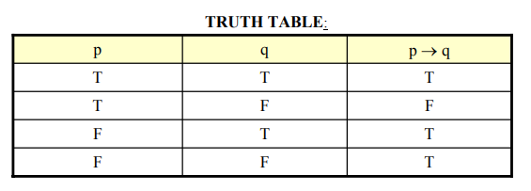

Slide 8
PRACTICE WITH CONDITIONAL STATEMENTS:
Determine the truth value of each of the following conditional statements:
1. “If 1 = 1, then 3 = 3.” TRUE
2. “If 1 = 1, then 2 = 3.” FALSE
3. “If 1 = 0, then 3 = 3.” TRUE
4. “If 1 = 2, then 2 = 3.” TRUE
5. “If 1 = 1,then 1 = 2 and 2 = 3.” FALSE
6. “If 1 = 3 or 1 = 2 then 3 = 3.” TRUE

Slide 9
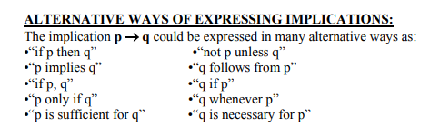

Slide 10
TRANSLATING SYMBOLIC PROPOSITIONS TO ENGLISH:
Let p, q, and r be the propositions:
p = “you have the flu”
q = “you miss the final exam”
r = “you pass the course”
Express the following propositions as an English sentence.
1. p → q
If you have flu, then you will miss the final exam.
2. ~q → r
If you don’t miss the final exam, you will pass the course.
3. ~p ∧ ~q→ r
If you neither have flu nor miss the final exam, then you will pass the course.

Slide 11

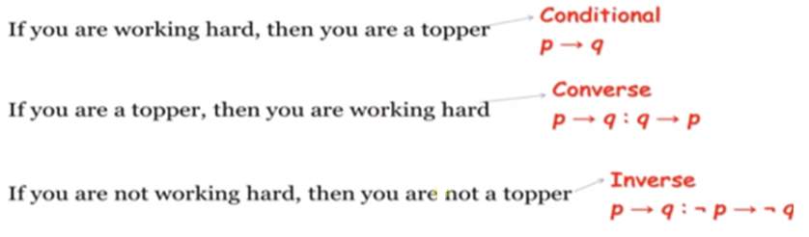
CONVERSE INVERSE CONTRAPOSITIVE
The proposition p → q. is called the converse of q → p
The contrapositive of p → q is the proposition ￢q →￢p.
The proposition p → q. is called the inverse of ￢p →￢q

Slide 12
WRITING INVERSE:
1. If today is Friday, then 2 + 3 = 5.
If today is not Friday, then 2 + 3 ≠ 5.
2. If it snows today, I will ski tomorrow.
If it does not snow today I will not ski tomorrow.
3. If P is a square, then P is a rectangle.
If P is not a square then P is not a rectangle.
4. If my car is in the repair shop, then I cannot get to class.
If my car is not in the repair shop, then I shall get to the class.

Slide 13
WRITING CONVERSE:
1.If today is Friday, then 2 + 3 = 5.
If 2 + 3 = 5, then today is Friday.
2.If it snows today, I will ski tomorrow.
I will ski tomorrow only if it snows today.
3. If P is a square, then P is a rectangle.
If P is a rectangle then P is a square.
4. If my car is in the repair shop, then I cannot get to class.
If I cannot get to the class, then my car is in the repair shop.

Slide 14
1.If today is Friday, then 2 + 3 = 5.
If 2 + 3 ≠ 5, then today is not Friday.
2.If it snows today, I will ski tomorrow.
I will not ski tomorrow only if it does not snow today.
3. If P is a square, then P is a rectangle.
If P is not a rectangle then P is not a square.
4. If my car is in the repair shop, then I cannot get to class.
If I can get to the class, then my car is not in the repair shop.

Slide 15
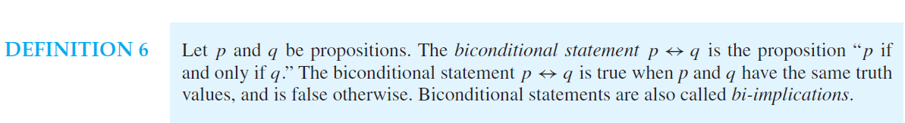
BICONDITIONALS
Example
Let p be the statement
“You can take the flight.”
and let q be the statement
“You buy a ticket.”
Then p ↔ q is the statement
“You can take the flight if and only if you buy a ticket.”

Slide 16

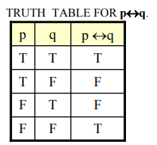

Slide 17
REPHRASING BICONDITIONAL:
p↔q is also expressed as:
o “p is necessary and sufficient for q”
o “If p then q, and conversely”
o “p is equivalent to q”

Slide 18
Precedence of Logical Operators
Operator Precedence
¬ 1
∧ 2 ∨ 3
→ 4 ↔ 5

Slide 19
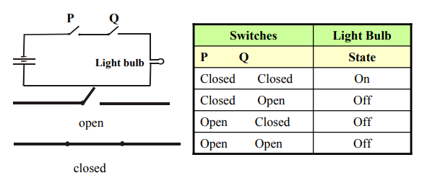
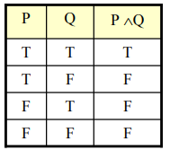
APPLICATION OF LOGIC

Slide 20
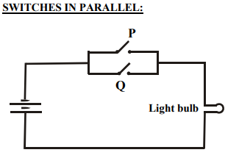
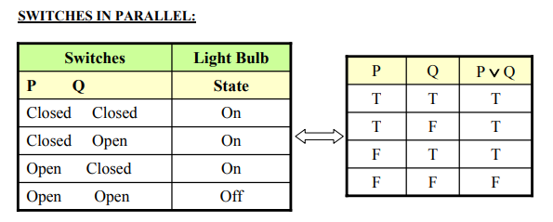

Slide 21

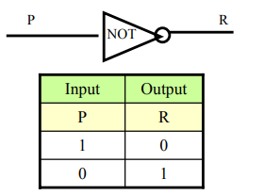
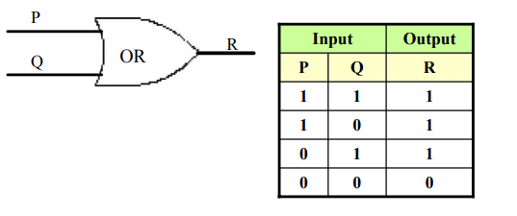
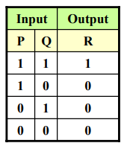
LOGICAL GATES

Slide 22
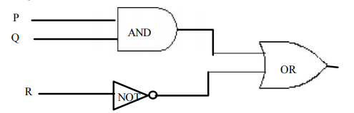
COMBINATIONAL CIRCUIT: A Combinational Circuit is a compound circuit consisting of the basic logic gates such as NOT, AND, OR.

Slide 23
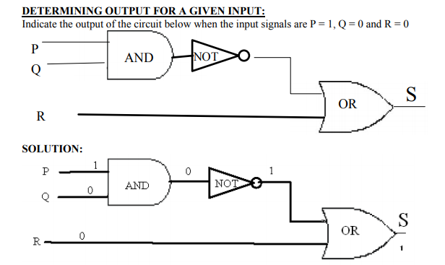

Slide 24
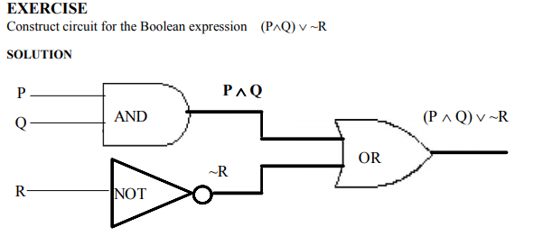

Slide 25
Argument
we first consider the following argument:
An argument is a list of statements called premises (or assumptions or hypotheses) followed by a statement called the conclusion.
P1 Premise
P2 Premise
P3 Premise
. . . . .. . . . .
Pn Premise
______________
∴C Conclusion
NOTE: The symbol ∴ read “therefore” is normally placed just before the conclusion

Slide 26
VALID AND INVALID ARGUMENT:
An argument is valid if the conclusion is true when all the premises are true.
(P1∧ P2 ∧ P3 ∧ . . . ∧ Pn) → C is a tautology.
An argument is invalid if the conclusion is false when all the premises are true
Critical Rows: The critical rows are those rows where the premises have truth value T.

Slide 27
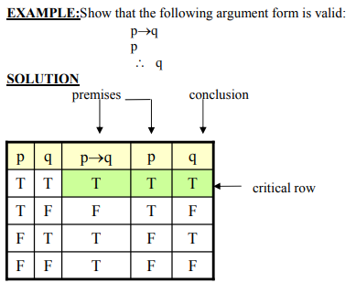

Slide 28
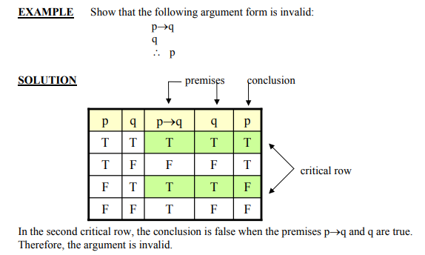

Slide 29
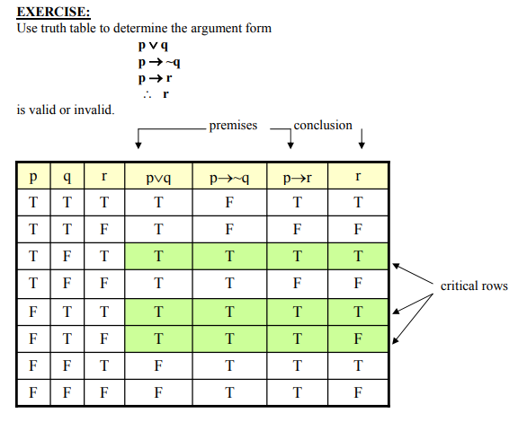
In the third critical row, the conclusion is false when all the premises are true. Therefore, the argument is invalid

Slide 30
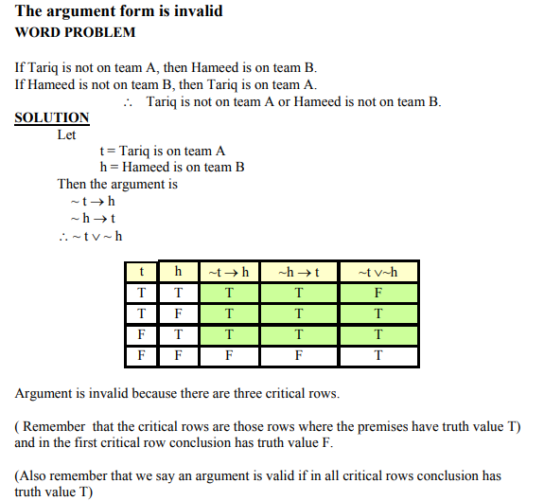

Slide 31
